Slide 1
HONORS & AP
We talk about “college and career ready” a lot.
But what does it really mean?

Slide 2
Honors & AP mean
Above average
  Content
  Pace
  Independence
  Responsibility
The course
The students

Slide 3
High school is a transition
Teacher led Self-directed
Elementary/Middle High School Career/College
C
H
I
L
D
A
D
U
L
T
YOU

Slide 4
College
Many go to college, only half are really ready

Slide 5
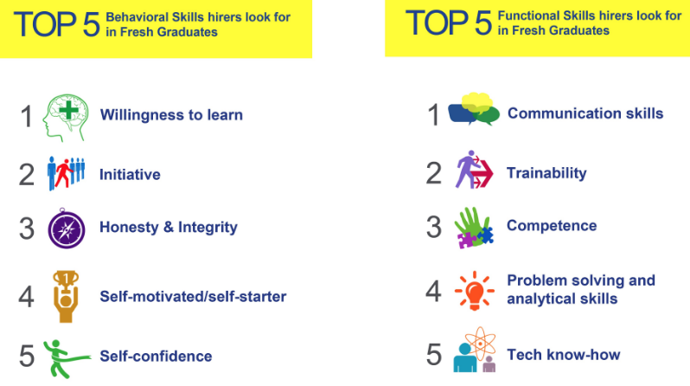
career

